Slide 1


How to Enhance that UI with PCF
Rami Mounla
Solution Architect | Power Platform | DXC NZ

Slide 2
You, Me, and the Power Platform

Slide 3


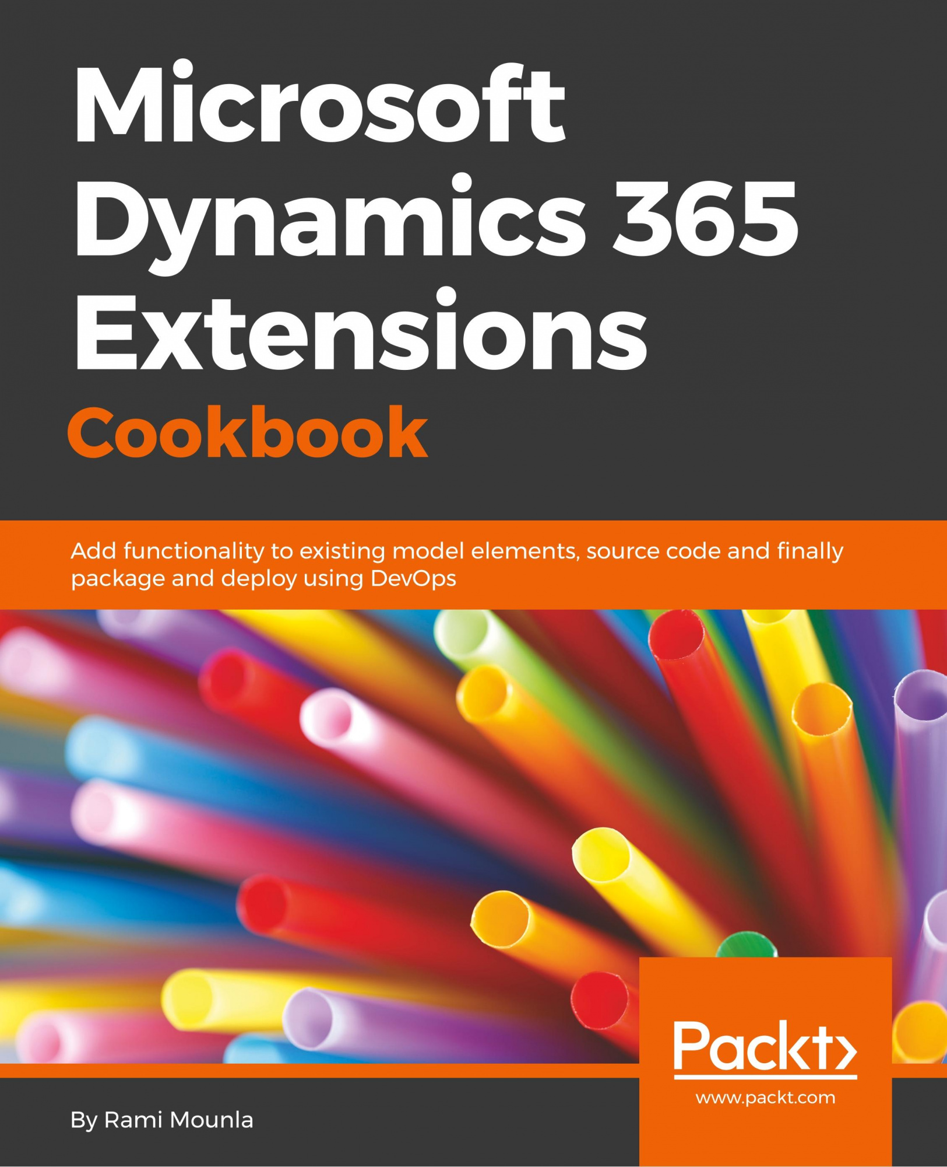



Slide 4
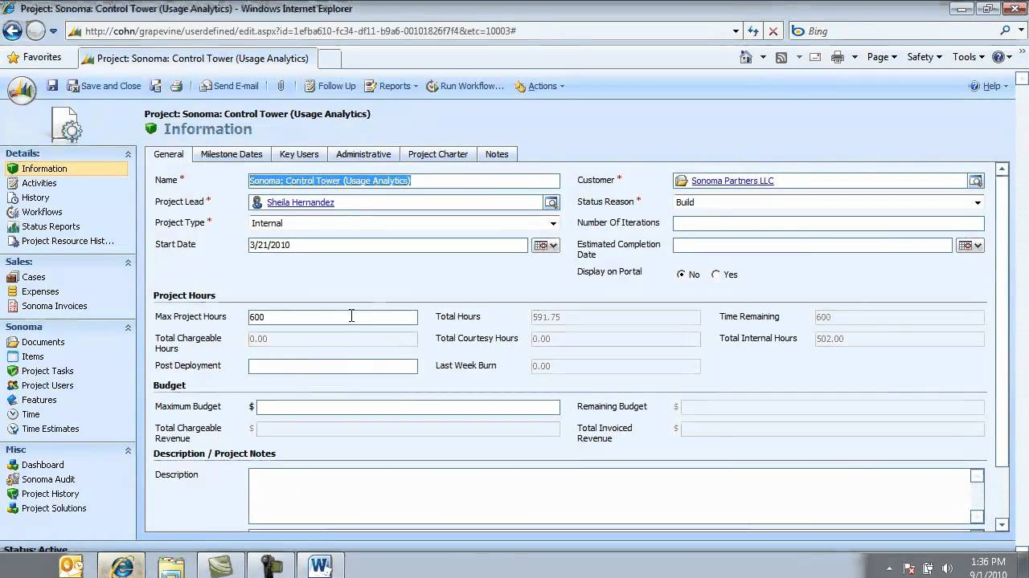

Slide 5
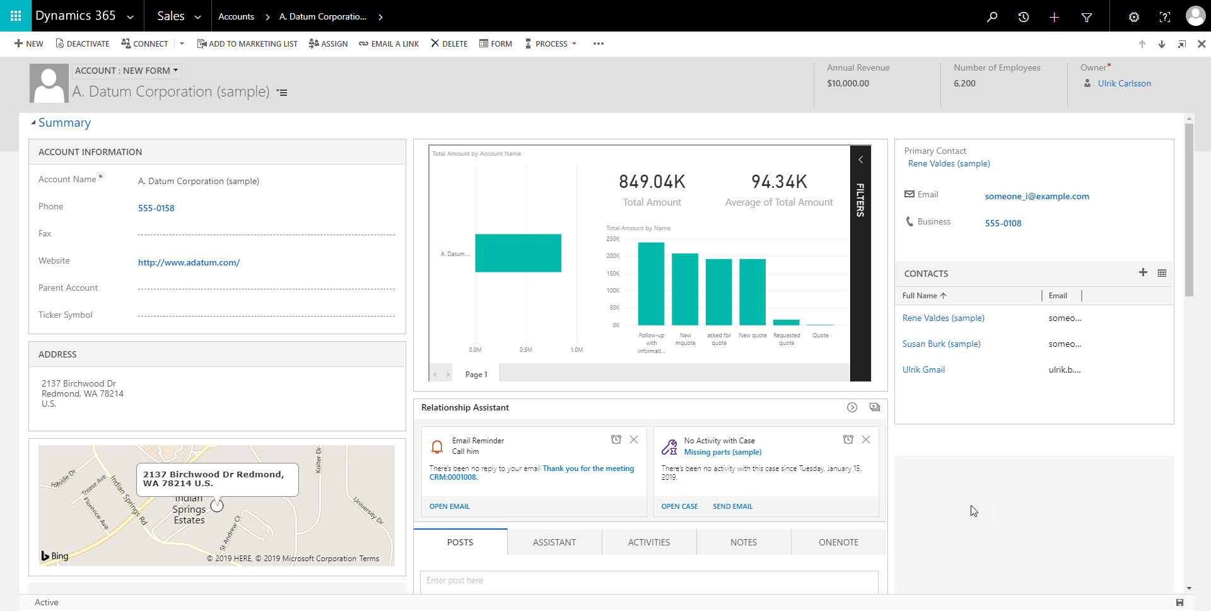

Slide 6
What is the Power Platform Component Framework?

Slide 7


Slide 8
Examples

Slide 9
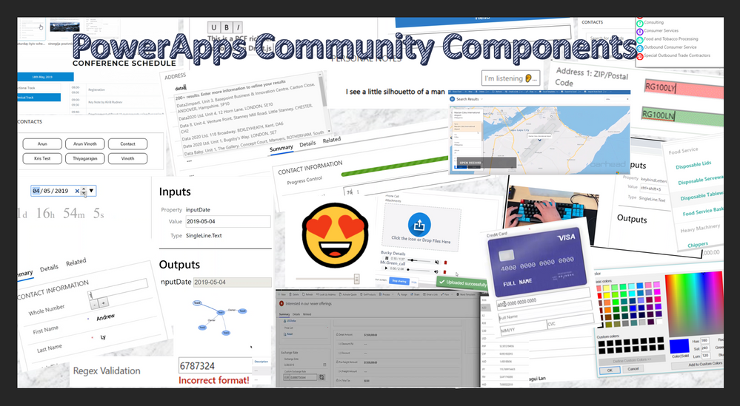

Slide 10
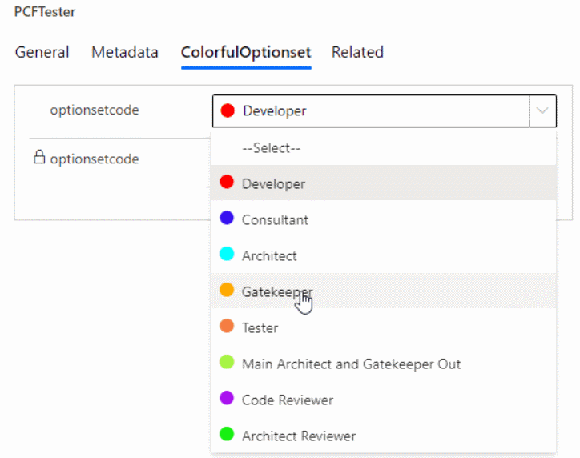

Slide 11
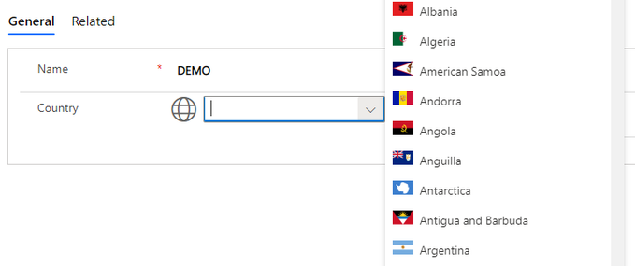

Slide 12
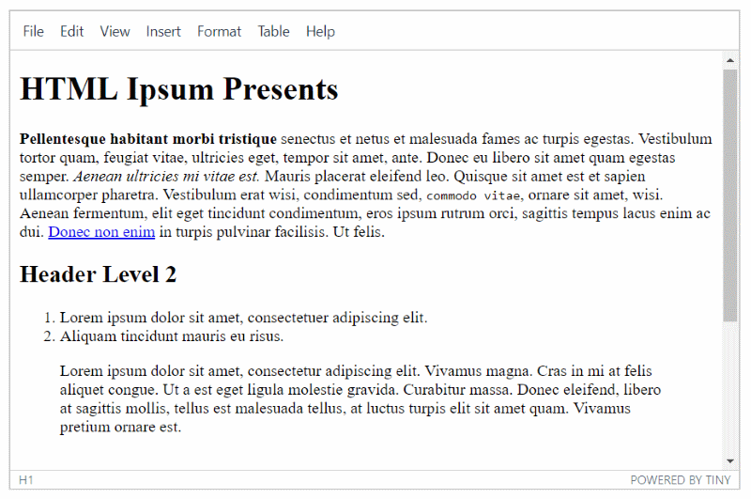

Slide 13
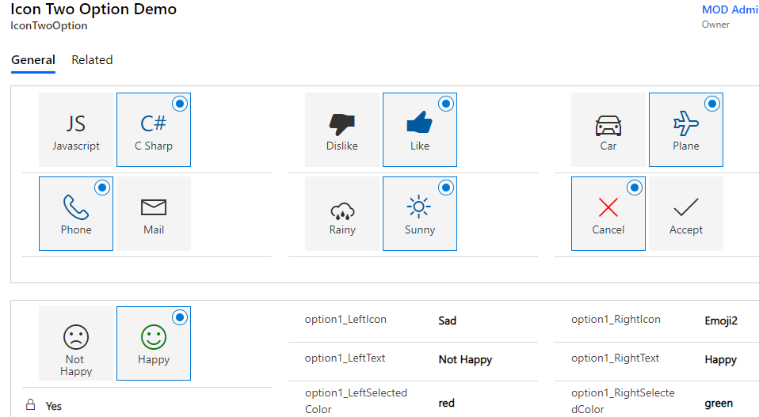

Slide 14
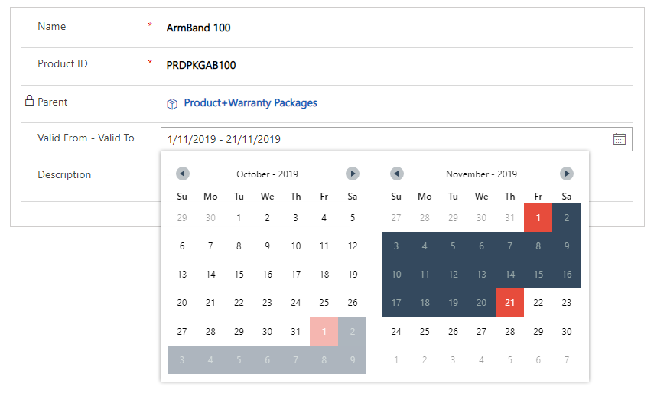

Slide 15
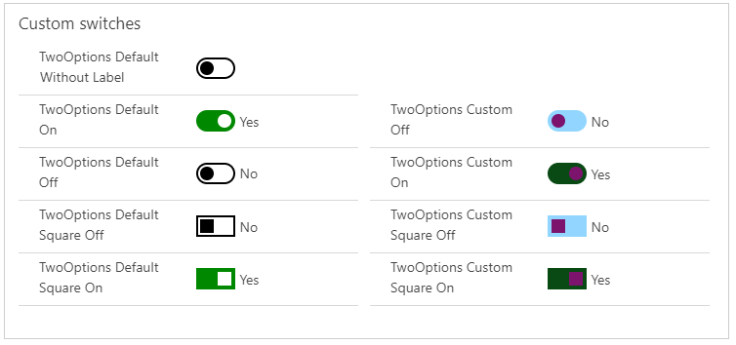

Slide 16
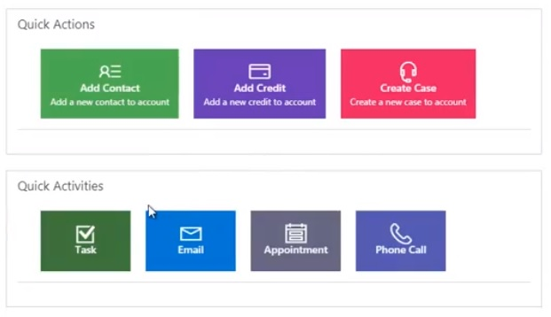

Slide 17
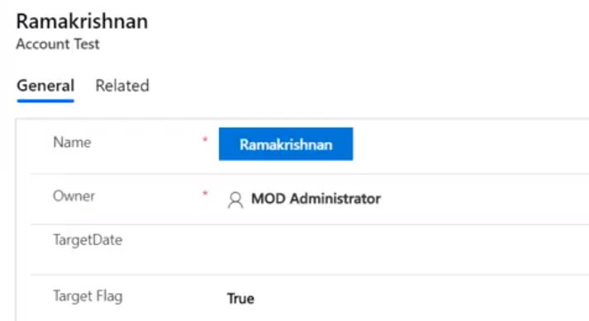

Slide 18
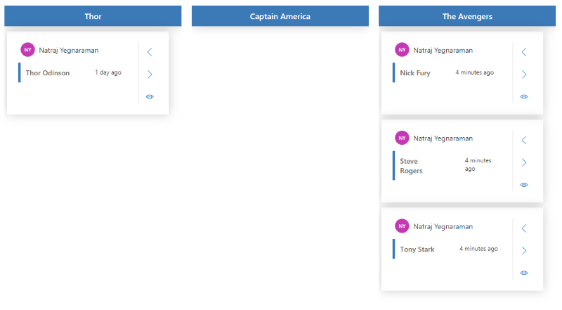

Slide 19
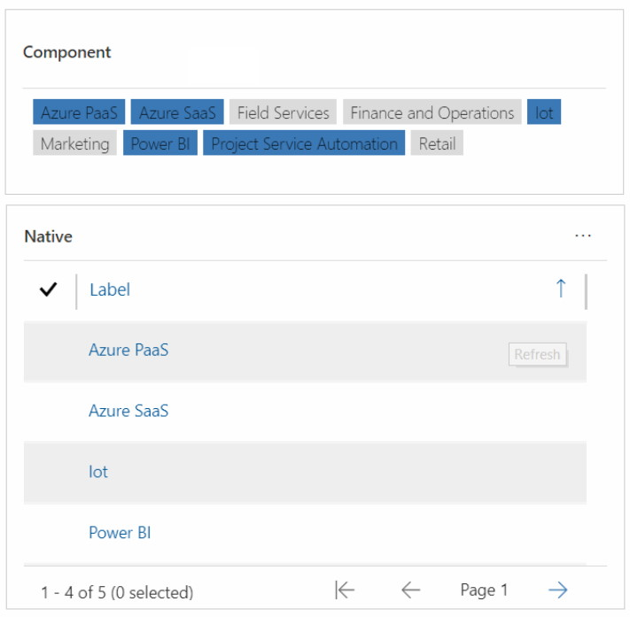

Slide 20
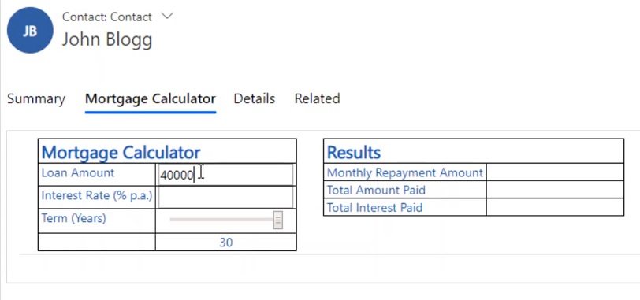

Slide 21
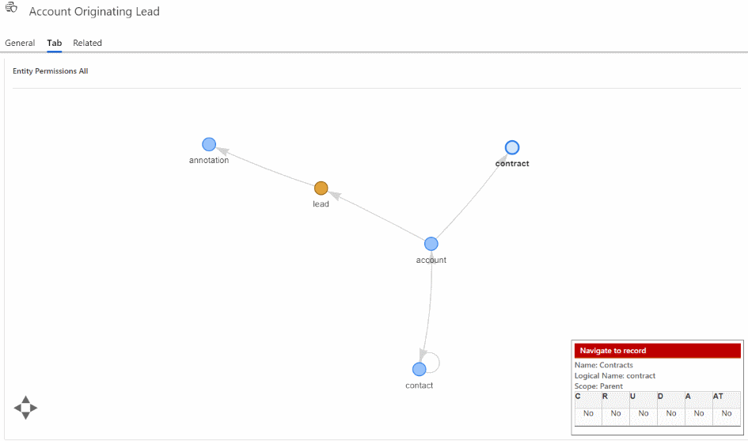

Slide 22
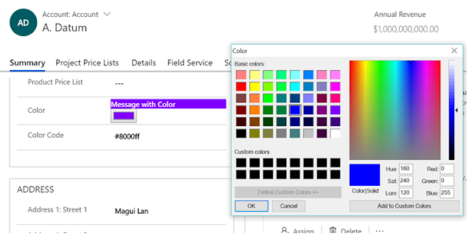

Slide 23
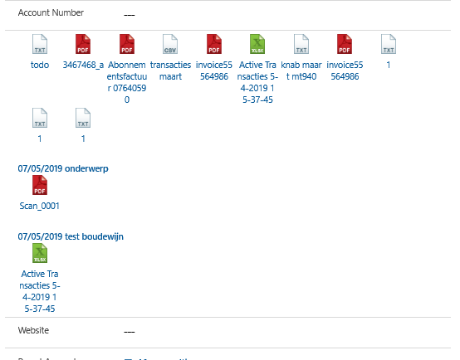

Slide 24
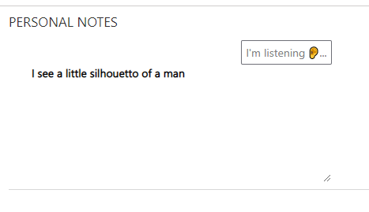

Slide 25
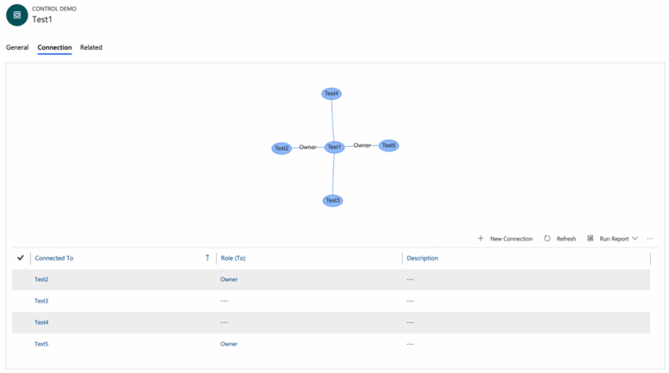

Slide 26
NZ specific ones

Slide 27
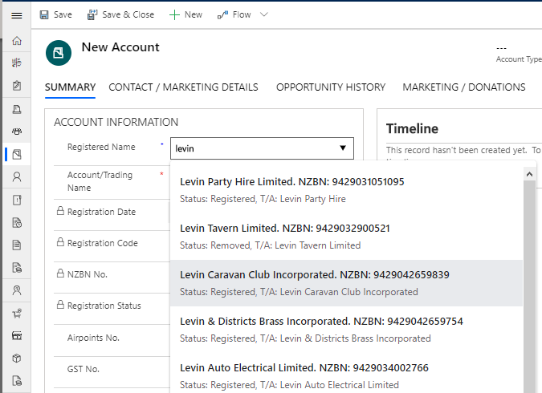

Slide 28
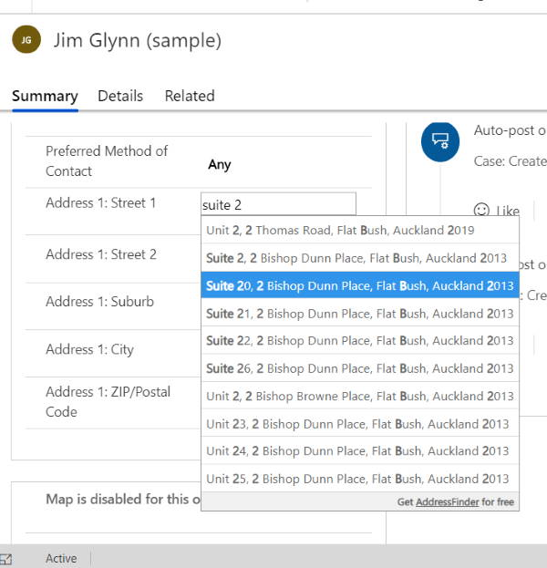

Slide 29
Field v Data Sets

Slide 30
Learning Curve
What you need to know

Slide 31
Technologies
NPM
TypeScript
HTML + CSS

Slide 32


Slide 33
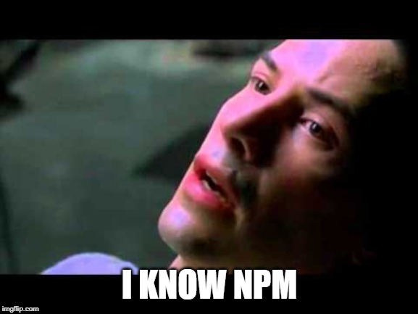

Slide 35
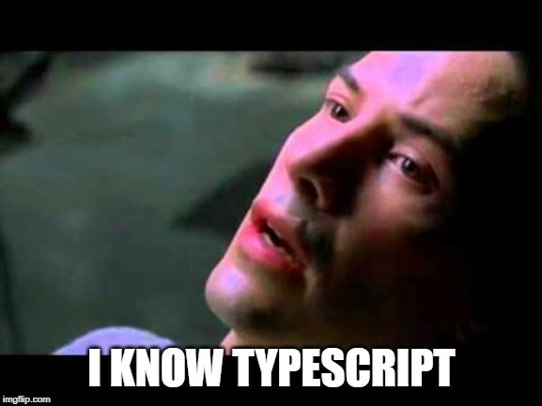

Slide 36
Getting Started

Slide 37
Prerequisites
NPM (from comes with Node.js)
.NET Framework 4.6.2 Developer Pack
Power Apps CLI

Slide 38
The 8 Commands
That you really need to know

Slide 39
Cheat Sheet Create Control
pac pcf init --namespace XrmEnterprise --name CalendarView --template dataset
1. pac pcf init --namespace XrmEnterprise --name Tile --template field
2. npm install
3. npm run build
4. npm start

Slide 40
Cheat Sheet Package Control
5. pac solution init --publisher-name XrmEnterprise --publisher-prefix xe
6. pac solution add-reference --path ..\CalendarView
7. msbuild /t:restore
8. msbuild

Slide 41
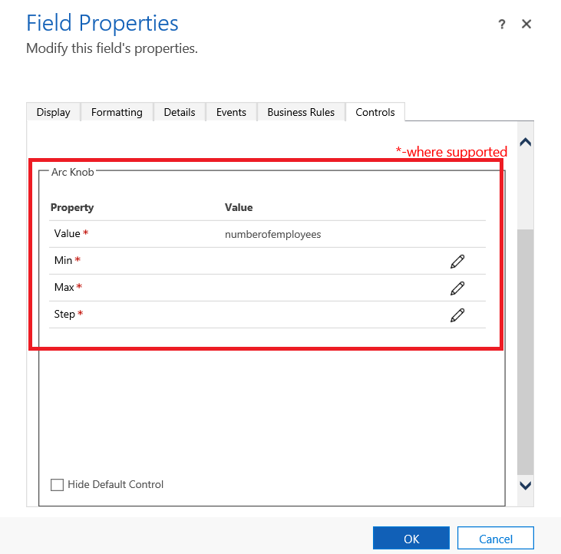

Slide 42
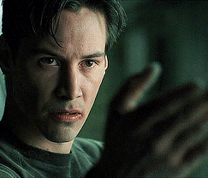

Slide 43
The Structure
That you really need to know

Slide 44
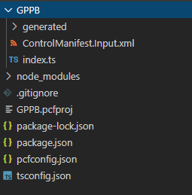

Slide 45
Example: Field

Slide 46
Example: Dataset

Slide 47


Slide 48
My Examples

Slide 49
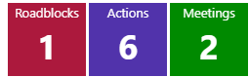

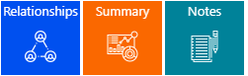

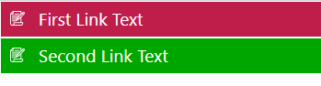

Slide 50
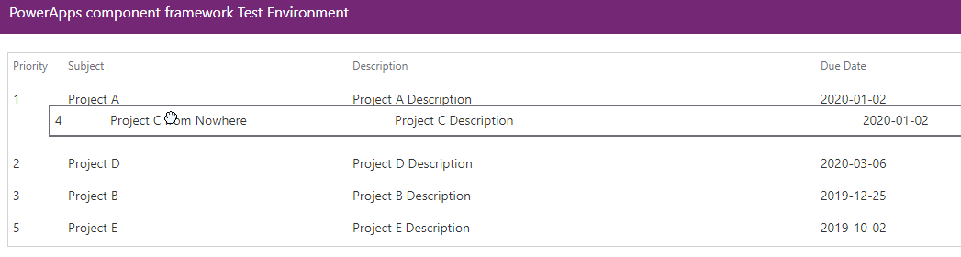

Slide 51
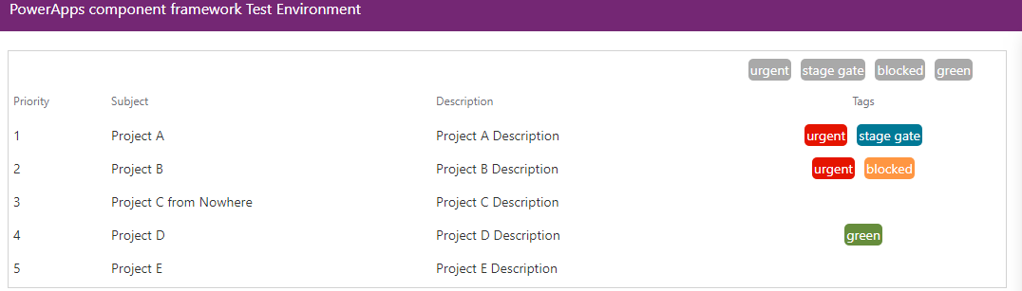

Slide 52
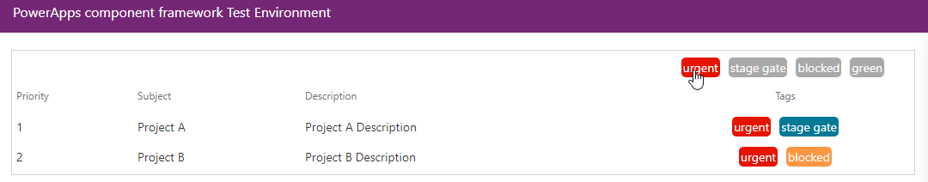

Slide 53
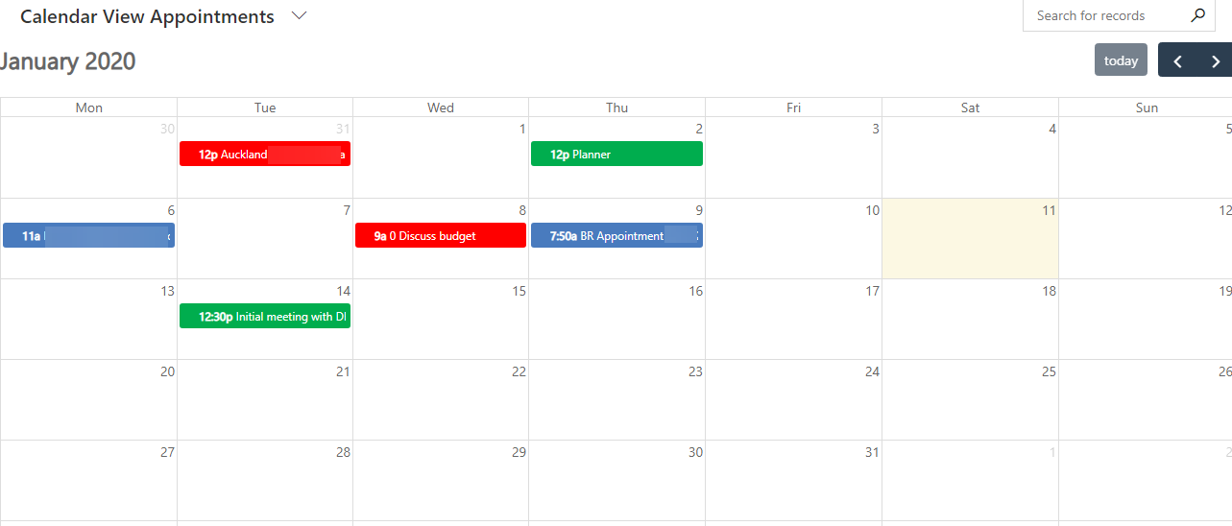

Slide 54
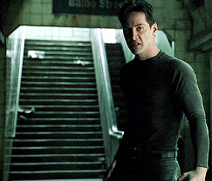

Slide 55
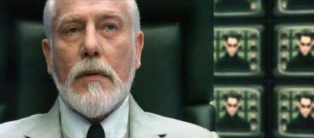
Useful links
Microsoft Documentation
https://docs.microsoft.com/en-us/powerapps/developer/component-framework/overview
Rami’s Samples
https://github.com/ramimounla
PCF Gallery
https://pcf.gallery/
Andrew Butenko
https://www.youtube.com/channel/UCjXCqDkRAGFAtu2JlWr3Epg
XrmToolbox
https://www.xrmtoolbox.com/plugins/Maverick.PCF.Builder/

Slide 56


Slide 57

Thank you

